Slide 1
Vx EOS Workshop
Development Requirements

Slide 2
Hardware
Requirements

Slide 3
Hardware Requirements
Predator terminals with 6+MB of memory
  Vx510 ( for example: M251-563-36-AUA)
    OS version QA001216 or newer
  EOS does not support “on chip” IP stacks like Vx510 with Connect One chip
Any Trident based terminal
  Typical memory configuration:
  RAM – 32 to 64 MB
  Flash – 128 MB
SmartCard Reader (To be used by the new File Signing Tool)
File Signing Card
VeriFone Confidential

Slide 4
Compiler
Requirements

Slide 5
Compiler Requirements
RVDS 4.0 compiler
VRXCC compiler flags
  -b flag (how VFI SDK interpret this flag)
    vrxcc compile : generate ARM-9 code. This is the default.
    vrxcc link : 4kb align the output
    vrxlib : the interface file (.o) will have ARM-9 instructions. The .lib will be 4kb aligned
VeriFone Confidential

Slide 6
Compiler Requirements
VRXCC compiler flags
  -p
    generates code for ARM11
    Support apps that will only run on Trident
VeriFone Confidential

Slide 7
DTK Requirements
Must use DTK 10.0.0 or later
SDK 3.3.0B
VxEOS Package
  1.0.0.15 (VxEOS-01000015) – For Predator / ARM9
  1.0.1.18 (VxEOS-01000118) – For Trident / ARM11
VeriShield File Signing Tool 3.01.07
VeriFone Confidential

Slide 8
VeriShield File Signing Tool

Slide 9
VeriShield FileSigning Tool
No longer supports Default certificate
Applications must be signed with the new file signing process
Requires VeriShield File Signing Tool 3.01.07 or later
Requires a FileSigning SmartCard
FileSigning SmartCard should have:
  Platform: Verix eVo
  Partition: Application
P7S file produced is unique per card
File Signing Process is via the GUI tool
VeriFone Confidential

Slide 10
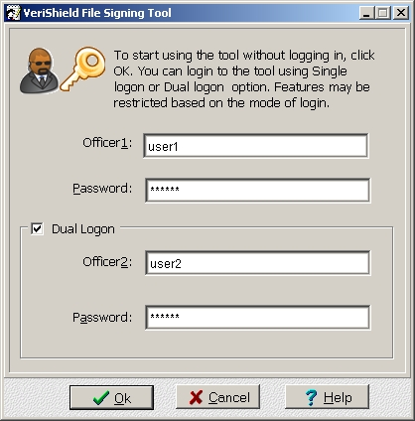
File Signing Process
Load the VeriShield File Signing Tool. By default, this is located on All Programs->VeriFone->VeriShield->File Signing Tool
The Login screen shows up. Make sure that the Dual Logon option is selected
VeriFone Confidential

Slide 11
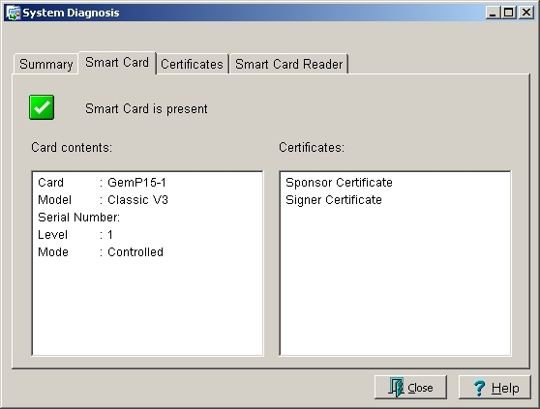
File Signing Process
Make sure that a File Signing Card is present on the SmartCard reader and is readable by the File Signing Tool. To verify, click the Diagnostics button.
From the dialog box, click the Smart Card tab to verify the contents. Left panel shows the Content such as your card’s serial number. On the right panel, you should be able to see 2 certificates: Sponsor Certificate and Signer Certificate
VeriFone Confidential

Slide 12
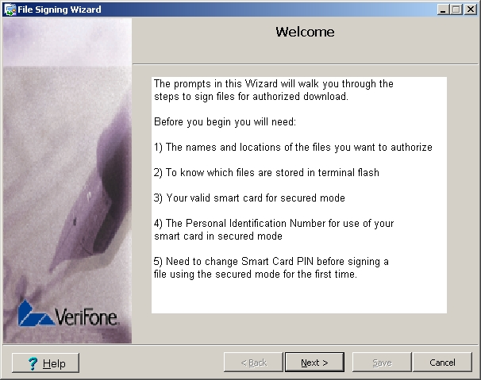
File Signing Process
Now, when everything is properly set up, click the Sign File button. A welcome screen appears. Click next.
VeriFone Confidential

Slide 13
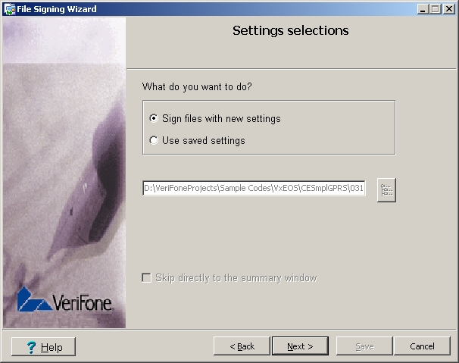
File Signing Process
From the Settings Selections screen, you were given an option to choose whether to sign files with new settings or use a a saved settings from a .FST file. For now, we will sign the files with a new settings
VeriFone Confidential

Slide 14
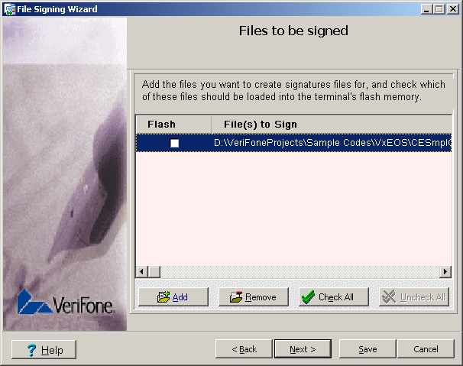
File Signing Process
Add files to be signed. Make sure that the Flash check box is not checked
VeriFone Confidential

Slide 15
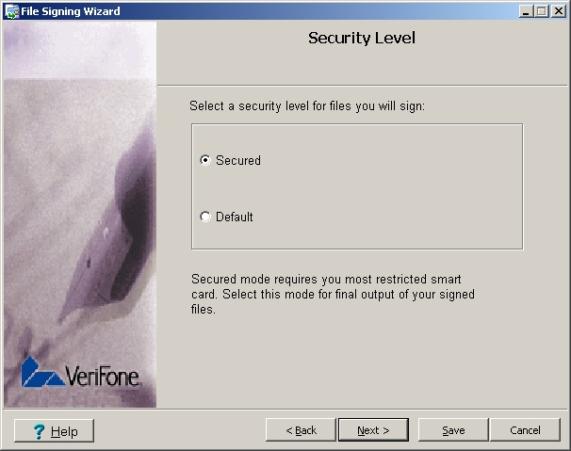
File Signing Process
Since new OS no longer supports Default certificates, make sure that the Secured option is selected
VeriFone Confidential

Slide 16
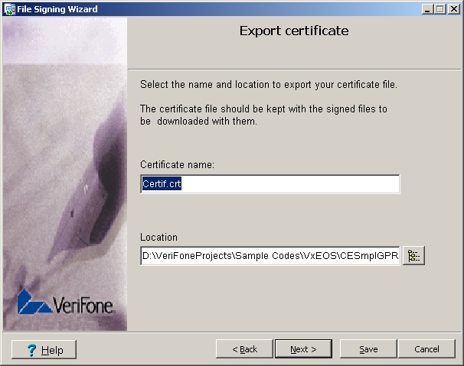
File Signing Process
Provide a name for the certificate file to be export which will be downloaded on the terminal later on
VeriFone Confidential

Slide 17
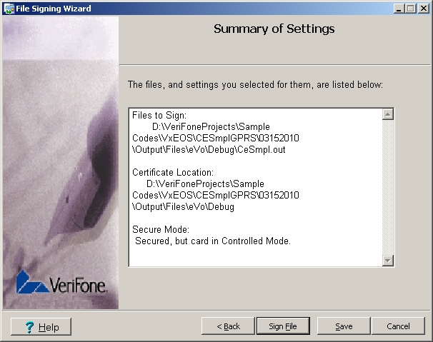
File Signing Process
Verify all the settings you’ve configured from the summary screen. Once verified, click the Sign File. The process may take a while so please be patient.
VeriFone Confidential

Slide 18
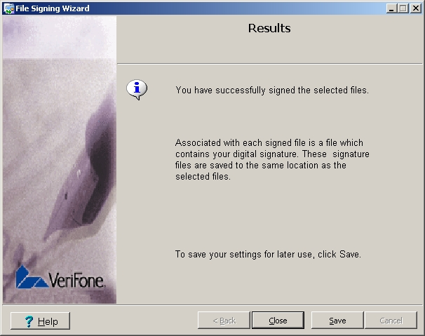
File Signing Process
Once completed, 3 files will be generated in the directory of the file to be signed. These files are:
  P7S file
  SponsorCert.crt
  Certif.crt (depending on what you’ve named from Step # 8)
VeriFone Confidential

Slide 19
Downloading The Certificates
Once the file signing process is successfully completed, it will produce 3 files: .P7S, SponsorCert.crt and Certif.crt
SponsorCert.crt and Certif.crt should be downloaded at least for the first time the application has been loaded
These 2 files are not required to be downloaded every time the signed file (for instance the .OUT file) are modified or updated as long as it was still signed by the same file signing card
VeriFone Confidential

Slide 20
Common Problems encountered when migrating to RVDS 4.0

Slide 21
Common problems encountered
Linker errors reported when building your app:
  Error: L6242E: Cannot link object printerIF.o as its attributes are incompatible with the image attributes.
  ... require 4-byte alignment of 8-byte datatypes clashes with require 8-byte alignment of 8-byte datatypes.
  Resolution:
  This error is likely caused by linking libraries previous to DTK 10 when compiling current app under RVDS 4.0. Make sure the path to the desired libraries are set properly. A good way of achieving this is to set the proper path at the beginning of the makefile.
VeriFone Confidential

Slide 22
Common problems encountered
Linking the library verix.lib or voy.lib and functions related to them generate linker errors like:
  Error: L6242E: Cannot link object beetle.o as its attributes are incompatible with the image attributes.
  Resolution:
  Verix V SDK has been made compatible with both versions of RVCT. But different libraries should be use for the different versions of RVCT.
    RVCT 2.0.1 should use verix.lib
    RVCT 4.0 should use verixn.lib or verix11.lib
    RVCT 2.0.1 should use voy.lib
    RVCT 4.0 should use voyn.lib
VeriFone Confidential

Slide 23
Common problems encountered
System Crash on using Position Independent Shared Libraries
  This can only happen on position independent libraries trying to call stdio functions such as sprintf
  Resolution:
  When using RVDS 4.0, both position and absolute independent can use stdio calls. However for position independent shared library, we must link clibPI.a for ARM9/Predator and clibPI11.a for ARM11 / Trident
VeriFone Confidential

